Slide 1
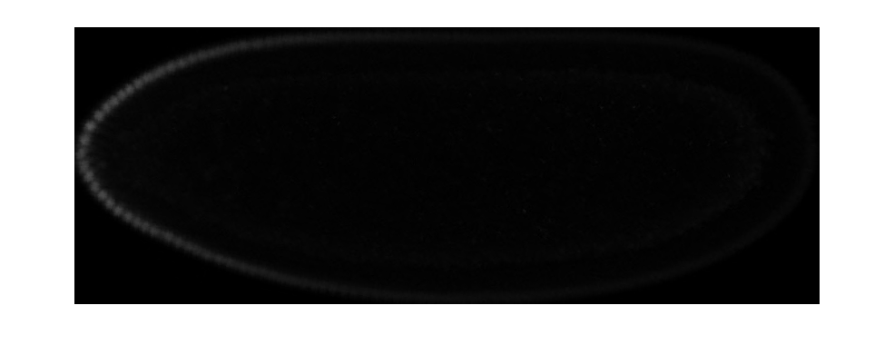
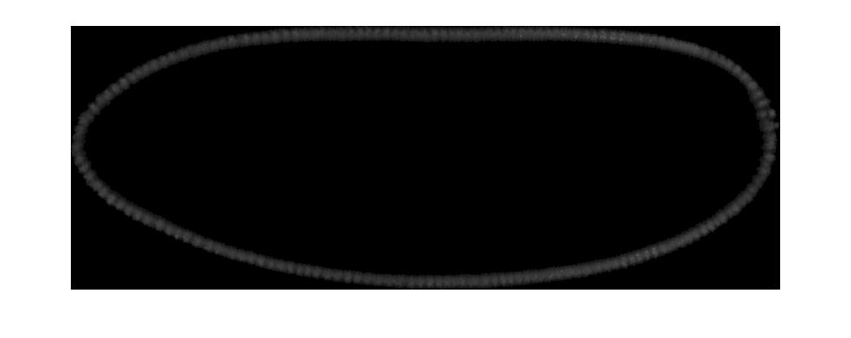
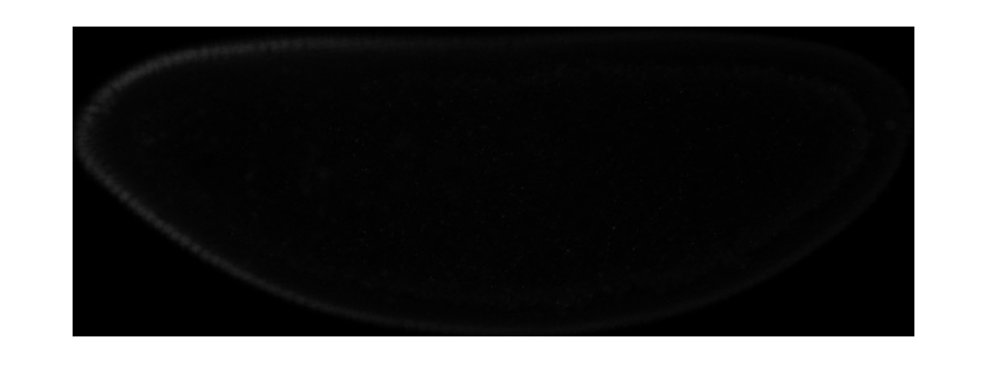
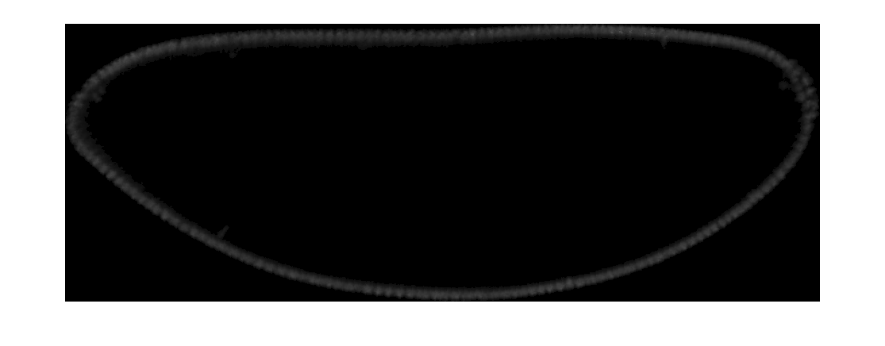
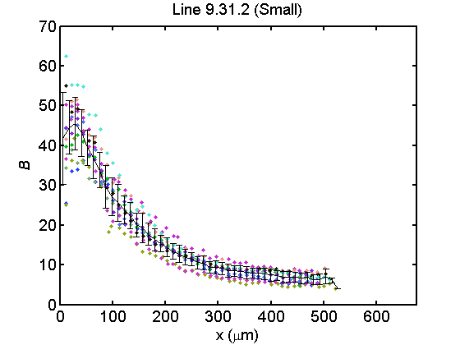
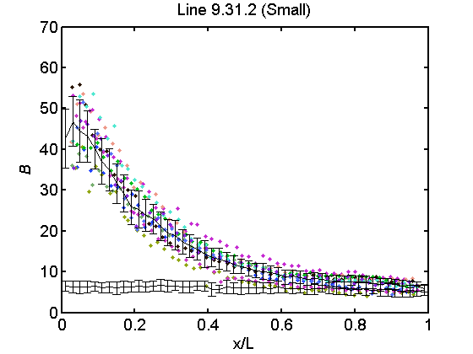
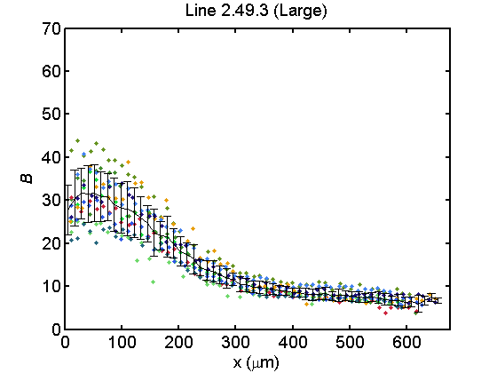
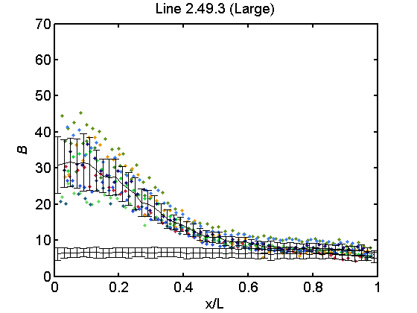
Bcd
DAPI
Line 9.31.2
Line 2.49.3
Figure 1

Slide 2
Figure 2

Slide 3
Figure 3

Slide 4
Figure X. The length constant is also scaled. Here we found the natural log of
Figure 4

Slide 5
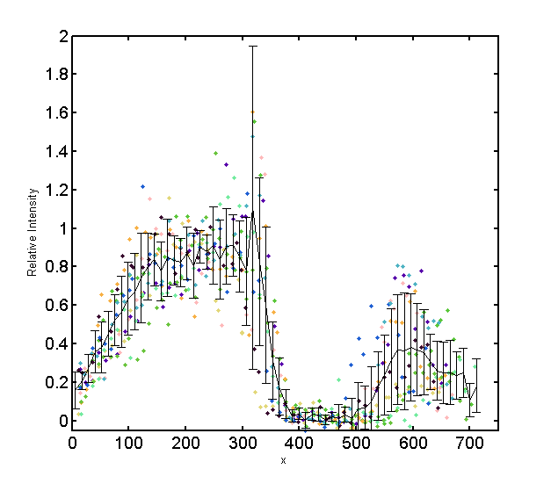
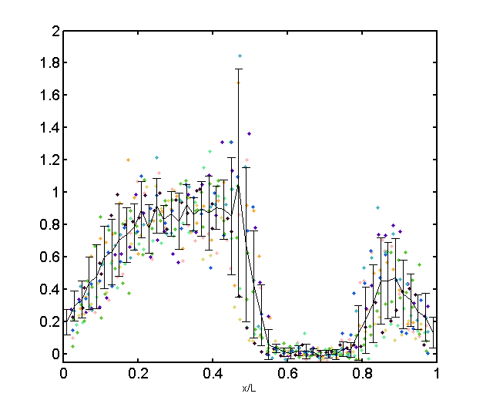
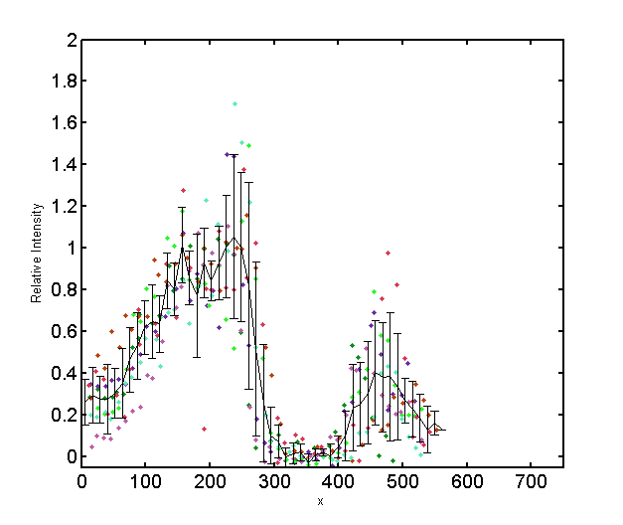
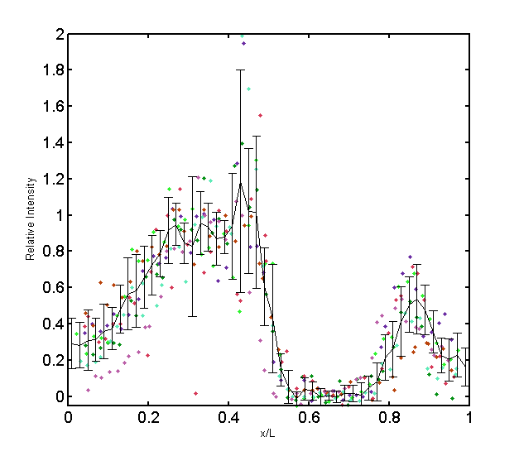
Line 2.49.3
n = 10
Line 9.31.2
n = 7

Slide 6
Mean Hb profiles reveal scaling
Figure 7

Slide 7
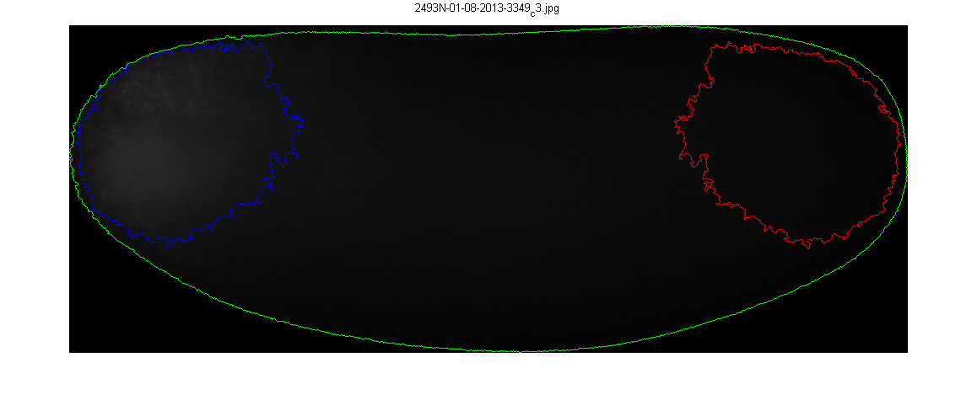
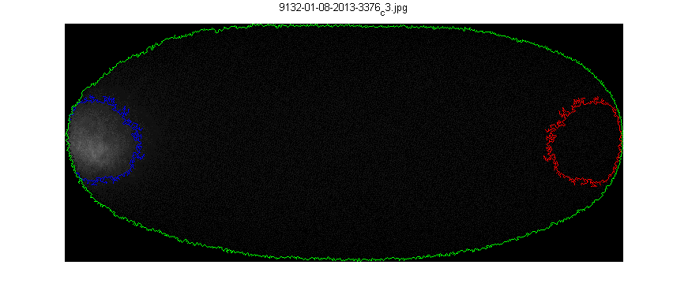
Line 2.49.3 (Large)
Line 9.31.2 (Small)
 | Egg Length (µm) | Intensity (a.u.) | Signal Area (µm²) | Egg Volume (µm³) | Embryo Area (µm²) | n
Line 2.49.3 | 666 ± 41 | 727747 ± 105254 | 26072 ± 8379 | 22141165 ± 3049121 | 315199 ± 30115 | 21
Line 9.31.2 | 498 ± 30 | 370214 ± 102166 | 8537 ± 5792 | 10518025 ± 1323310 | 188945 ± 16875 | 12
p-value | 1.51E-13 | 1.12E-10 | 3.88E-07 | 1.25E-13 | 2.28E-14
Figure 8, Table 1

Slide 8
Bicoid mRNA aggregate intensity is correlated to embryo size
A
Figure W. Bicoid mRNA aggregate intensity is correlated embryo size. (A, B) Here we show the aggregate fluoresence intensity of the identified specific signal region for Bicoid mRNA in embryos, from Line 2.49.3 and 9.31.2, and plotted them against (A) the egg length of each individual embryo or (B) the egg volume, as estimated by a prolate spheroid.
B
Figure 9

Slide 9
 | p-value
Line 2.49.3 vs Line 9.31.2 | 3.88E-07
Line 2.46.4 vs Line 9.17.1 | 0.4134
Table X. Bicoid mRNA distribution in Line 2.49.3 embryos is significantly higher than expected. A Student’s T test was performed on the signal area measurements between Lines 2.49.3 and 9.31.2, and Lines 2.46.4 and 9.17.1.
Figure X. Bicoid mRNA is more diffused in Line 2.49.3 embryos. (A) The area of the region bounded by the contour outline of the Bicoid mRNA specific signal was measured and plotted versus egg length for embryos from Line 2.49.3 (Blue) and Line 9.31.2 (Red). (A, inset) A similar comparison of the specific signal area for embryos with an analogous size disparity, Line 2.46.4 (Green) and Line 9.17.1 (Violet). *Awk Rephrase* Signal Area displayed in thousands.
Figure 10

Slide 10
A
B
C
Fig Y. Bicoid mRNA distribution is dosage independent. (A) The signal area for Bicoid mRNA in was measured in embryos with 1x (blue), 2x (red), and 3x (green) copies of Bicoid. (B, C) The Bicoid mRNA distribution for embryos containing different dosages was plotted against egg length (B) and egg volume (C).
Figure 11

Slide 11
A
B
Fig Z. Bicoid mRNA distribution is generally robust against differences in egg size. (A, B) Specific signal area of cage population embryos stained for Bicoid mRNA plotted against (A) egg length and (B) egg volume.
 | p-value
Cage 1 vs Cage 7 | 0.1053
Cage 1 vs Cage 8 | 0.0869
Cage 1 vs Cage 9 | 0.0117
Cage 2 vs Cage 7 | 0.0077
Cage 2 vs Cage 8 | 0.0069
Cage 2 vs Cage 9 | 3.34E-04
Cage 3 vs Cage 7 | 0.6478
Cage 3 vs Cage 8 | 0.5246
Cage 3 vs Cage 9 | 0.1153
Table Y. Bicoid mRNA distributions across a variety of populations are largely the same. Shown here is a table of p-values from a series of Student’s T-tests applied to different pairings of large and small embryos from different population cages.
Figure 12, Table 2

Slide 14
Eve

Slide 15
Figure S?

Slide 16
Large embryos contain more Bcd protein
Figure S?

Slide 17
Fig X. Scaling coefficients of embryos from Line 2.49.3 and 9.31.2 indicate hyposcaling. (A, B) The scaling coefficient, S, was calculated according to Bergmann from (A) interpolated Bicoid profile data (see text) and (B) measured Eve boundaries for Line 2.49.3 and 9.31.2 embryos pooled together.
Figure S?

